Slide 1
Process, elements and 3 models of communication
Dr. T. Sunand Emmanuel

Slide 2
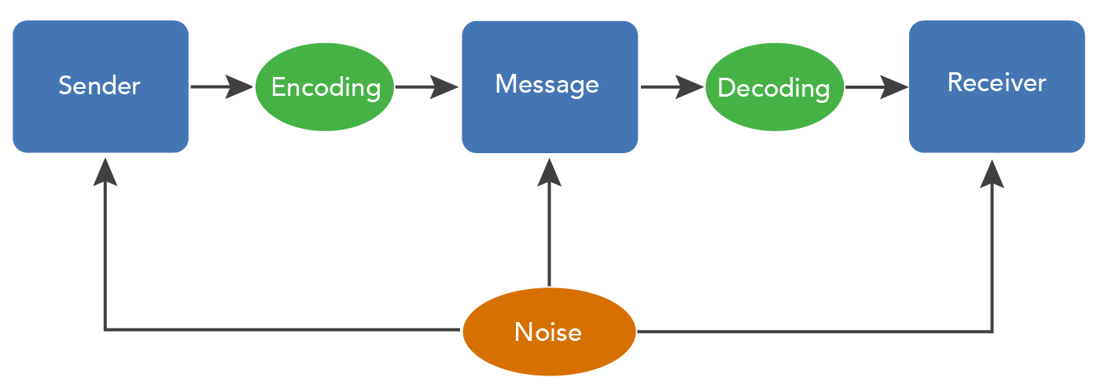
Process of communication

Slide 3
Elements of communication
Sender has ideas.
He encodes them using words (English/Telugu)
Now the message is ready.
He uses email or fax or whatsapp or video call or face-to-face or letter (channel) to pass on the message.
The receiver decodes them.
He gives feedback.
Despite best intentions, miscommunication will be there generally. (noise)
And all communication happens in a context (class room, home, canteen, park, etc.)

Slide 4
My dear CSE-A students, let us now see the three most popular models of communication:
Linear model of communication (1949)
Interactive model of communication (1954)
Transactional model of communication (1970)

Slide 5
3 Models of communication
Linear model of communication—Sender speaks to listener. Listener is supposed to understand. One-way communication.
MESSAGE
SENDER
RECEIVER

Slide 6
Interactive model of communication
Sender speaks. The listener listens silently. Now the listener speaks. The sender listens and gives feedback. It is a two-way process.
MESSAGE
FEEDBACK
RECEIVER
SENDER

Slide 7
Transactional model of communication
Both the sender and listener are communicators. Communication happens simultaneously. Even as I am speaking to you, you are observing me and thinking what to say and what not to say. (simultaneously!)
COMMUNICATOR
COMMUNICATOR

Slide 8
Summary
Linear model– Claude Shannon and Warren Weaver proposed it in 1949.
Interactive model – Wilbur Schramm proposed it in 1954.
Transactional model ---David C. Barnlund proposed it in 1970.

Slide 9
In linear model, receiver has no role.
Interactive model is better. There is feedback. But communication is even more complex. People simultaneously observe, analyse, think, assess what to say or what not to say SIMULTANEOUSLY. They are not passive.
So, transactional model of communication is more realistic.
Today, transactional model is recognised better than linear and interactive models.

Slide 10
Thank you

